Slide 1
Safe Harbor Statement
FORWARD-LOOKING STATEMENTS
Some of the information in the presentations constitute forward-looking information, including with respect to future product strategies, financial condition, results of operations, continued profitability and activities of Epicor. While these forward-looking statements represent our current judgment, these statements are based on assumptions that are subject to a wide range of risks and our actual results could differ materially. Epicor undertakes no obligation to revise or update publicly any forward-looking statements.

Slide 2
Unlocking Your Data – Business Intelligence Tools in BisTrack
Adam Bartlett
Data Systems Manager
Arnold Lumber Company
Steve Dodson
Chief Information Officer
Dodson Wholesale Lumber

Slide 3


Agenda
Development Environment | 04
Extending Dynamic Dashboards with JavaScript (A Recap) | 07
Dynamic Dashboard Drilldowns | 33
SVG Dashboards | 37
Charting | 41
Microsoft PowerBI | 45
WMS Examples | 50
Slides with this icon are included in the repo:
GitHub Repo

Slide 4
Development Environment

Slide 5

Notes:
This must be the butterfly of chaos theory of programming. I, too, love XKCD, by the way.

Slide 6
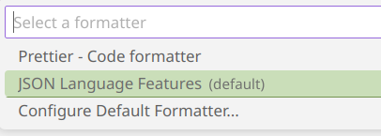
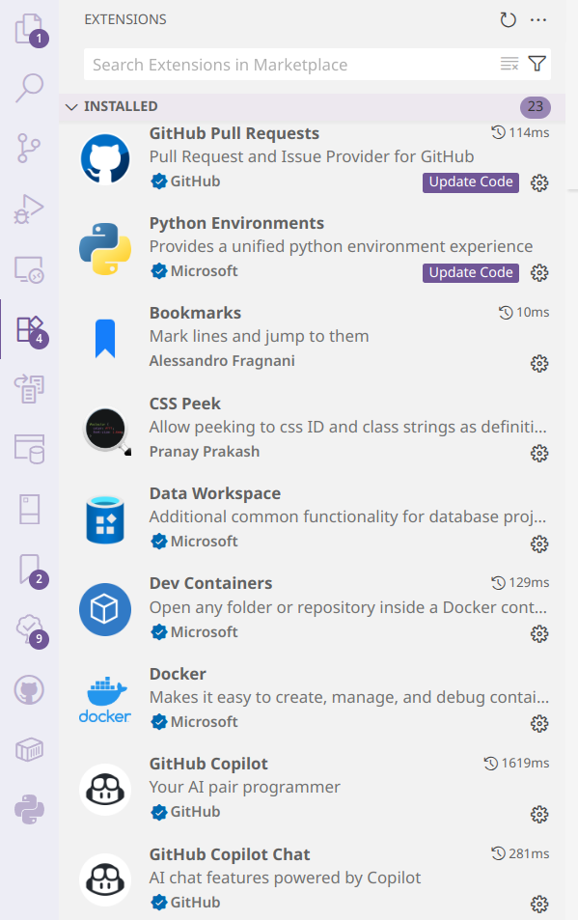
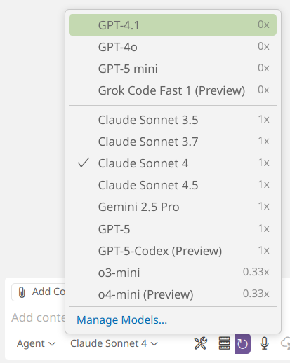
VS Code + Git + CoPilot
“Real Programmers” and their favorite text editor might have street cred…but a modern IDE with integrated AI adds incredible efficiency
VS Code Extensions
SQL Server (mssql --> Connect to btprod)
GitHub Copilot
GitHub Copilot Chat
GitHub Pull Requests
Code Formatters (JSON, SQL, HTML, etc.)
Version Control + Collaboration
Track changes
Share and/or Collaborate
GitHub Integrations
*Azure Data Studio officially retires 2/28/2026
Notes:
AI is perfect for HTML + CSS + Javascript (and still has limitations)
Private repos are worth maintaining – even (especially) if you are the only developer
Enable settings sync: Click on Gear icon in bottom left, Turn on Settings Sync

Slide 7
Extending Dynamic Dashboards with JavaScript (A Recap)

Slide 8
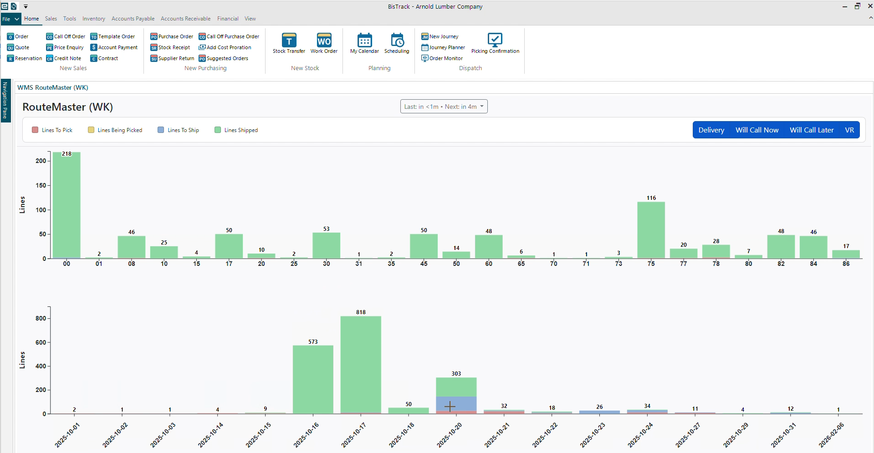
The Concept: Use Client-Side Web Stack to Improve Dashboards
Leverage Responsive, interactive, modern UI
Javascript Libraries
JQuery
Datatables, AG Grid, etc...
Charts.js, D3, etc...
Front end frameworks
React
Angular
Bootstrap/Tailwind, etc...
Bistrack's Dynamic Dashboard
Introduced in 2017, Version 6.0
Native access to MS SQL Server
Provides "hooks" for JavaScript/CSS
Limitations:
Dashboard formatting
Component constraints
Converting datasets to objects for consumption by JavaScript
No web server (i.e., file:// protocol)

Slide 9
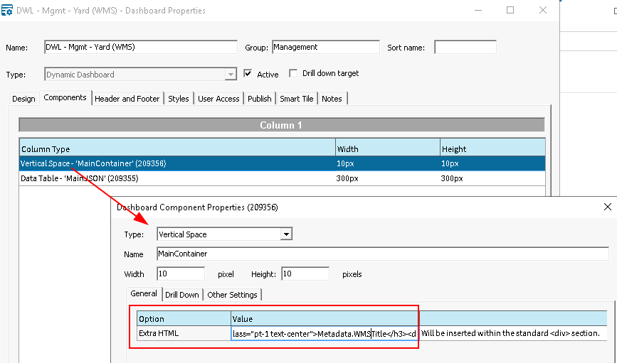
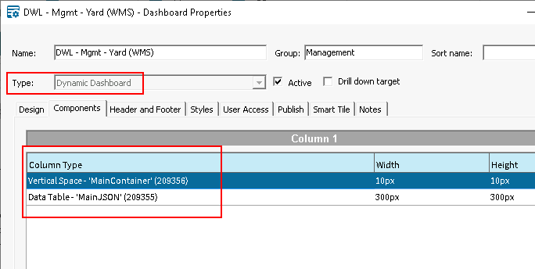
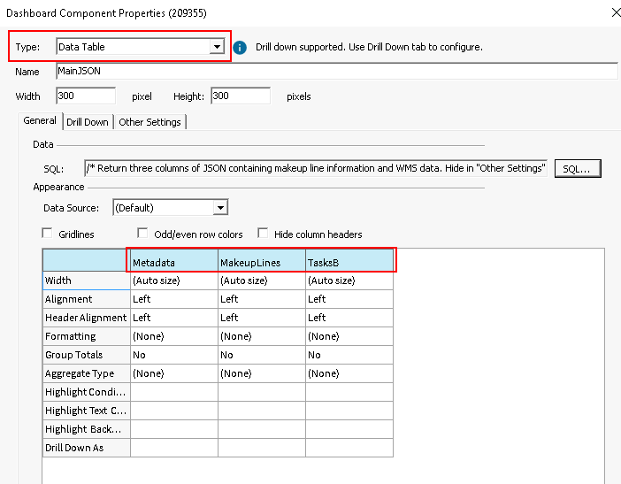
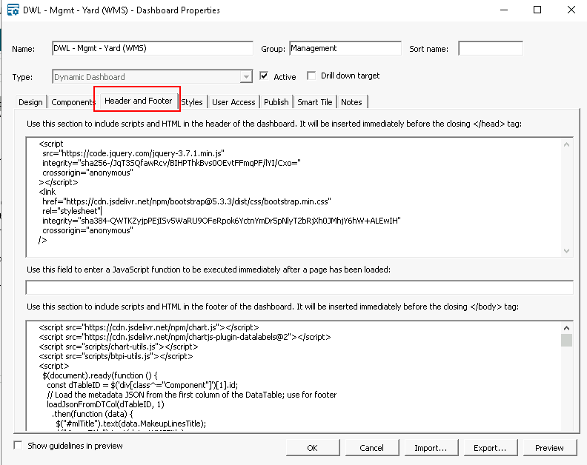
The "Rick" Approach
Dynamic Dashboard
Data Table Component
Use SQL to return JSON data in one or more columns
JSON is hidden using:
display:none; visibility:hidden; (set in “Extra Style” under “Other Settings”)
Vertical Space Component
Insert container <div> HTML directly into a Vertical Space component (Extra HTML) for content rendering
Additional Components (Drilldowns, etc.)
Custom Behavior
Add CSS & JavaScript in the Header and Footer tab
Consume hidden JSON

Slide 10
Example Dashboard
Notes:
Skip through these quickly; intended for reference material post conference

Slide 11
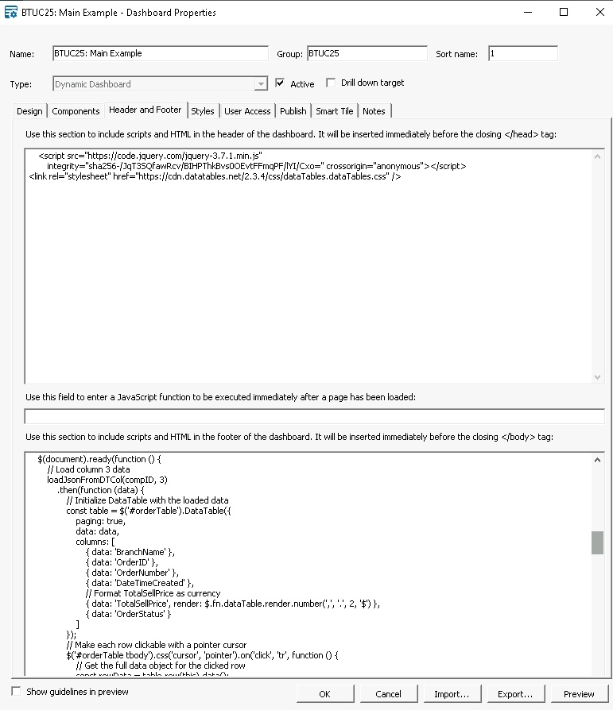
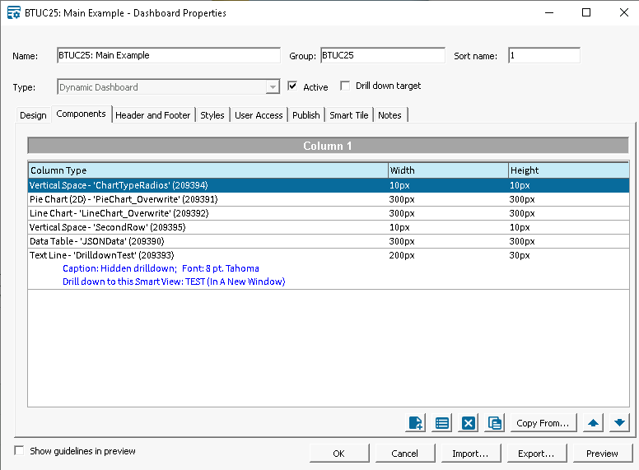
Example: Layout & JavaScript

Slide 12
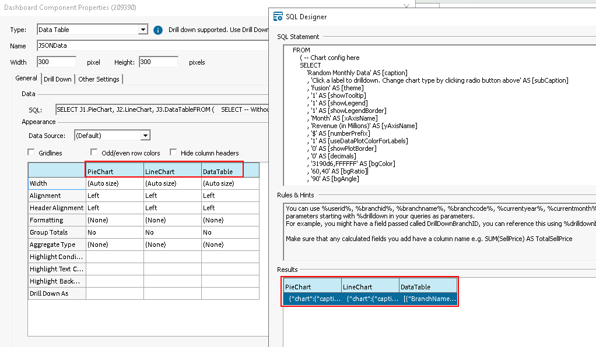
Example: DataTable with Three JSON Columns
Notes:
This example is a part of the downloads for this talk. See the "Notes" tab in the dashboard for more details.
The first two cols are FusionChart objects with a chart config component and data.
The third column is a JSON array for use with the datatable and fourth chart.

Slide 13
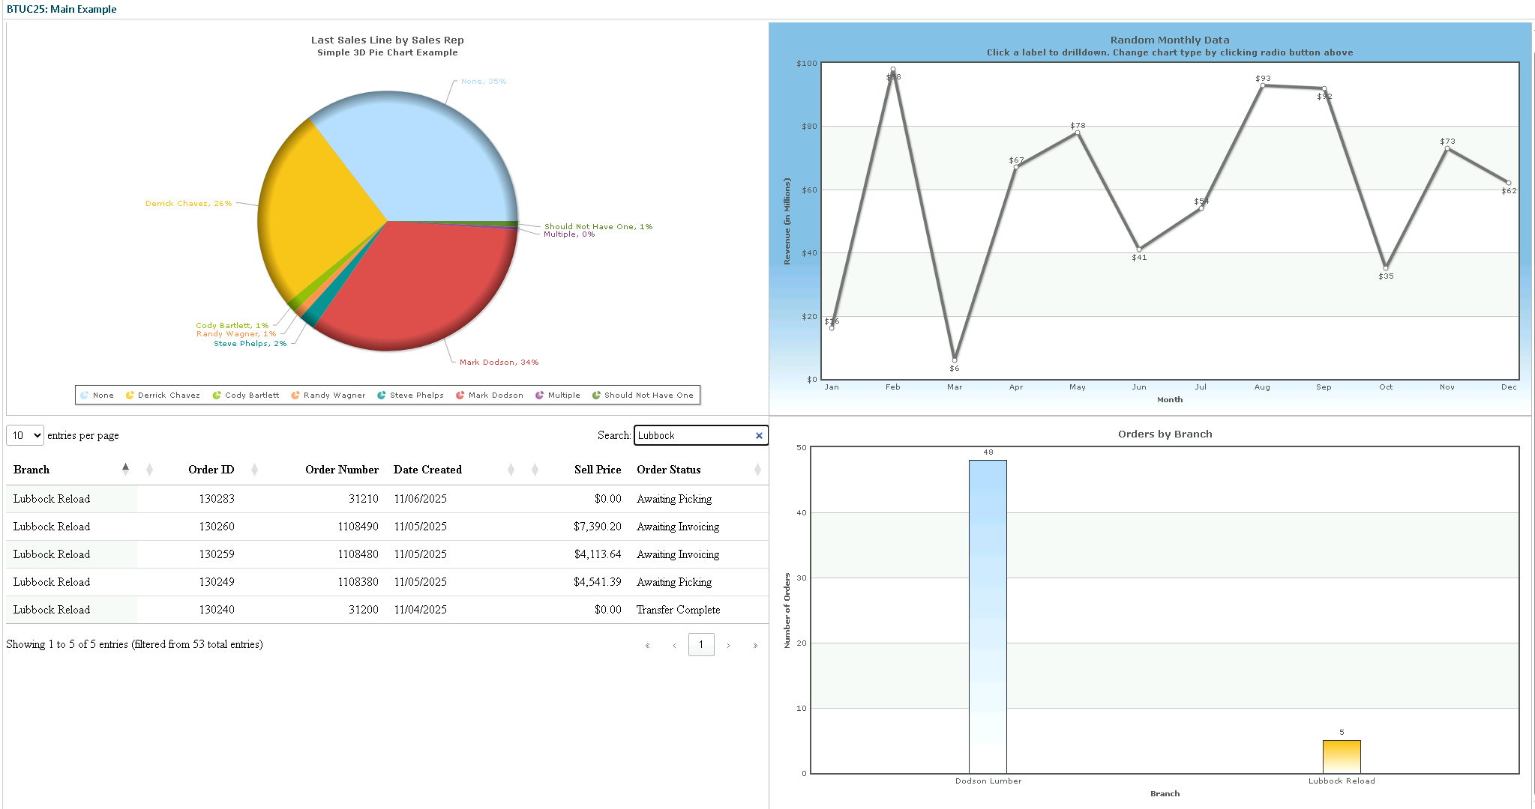
Example: Rendered

Slide 14
Tips & Tricks
Notes:
Skip through these quickly; intended for reference material post conference

Slide 15
JavaScript Copypasta
Rendered HTML Structure
Each DataTable appears with a component number (DashboardComponent.DashboardComponentID) and a class with the same number. E.g.:
Capture Component ID with jQuery
The following example captures the number for the second occurrence (0-indexed) in the Dashboard HTML. E.g.:
Access JSON Data
Pass the component ID and column index to this JavaScript to return a promise resolving to a JSON object
Example (column 1):
function loadJsonFromDTCol(DataTableID, colIndex) {
return new Promise((resolve, reject) => {
// Use jQuery to select the table cell at the specified index
const col = $(".Table" + DataTableID + " td:nth-child(" + colIndex + ")");
if (col) {
if (col.length > 0) {
const colData = col[0].innerHTML
.replace(/(?:\r\n|\r|\n)/g, "")
.replace(/\t/g, "")
.replaceAll(/[ ]{2,}/g, " ");
if (colData.length > 0) {
try {
resolve(JSON.parse(colData));
} catch (error) {
reject(
new Error(
`Failed to parse JSON from column data: ${error.message}`
)
);
}
} else {
reject(
new Error(
`Data for Table${DataTableID}, index ${colIndex} is empty`
)
);
}
} else {
reject(
new Error(
`Unable to locate DOM element Table${DataTableID}; check ID`
)
);
}
}
});
}
<div id="209355"class="Component209355">
const compID = $('div[class^="Component"]')[1].id;
loadJsonFromDTCol(compID, 1)
.then(function (data) {
console.log("Do something with the data object...");
})
.catch(function (error) {
console.error(error.message);
});
Notes:
I like to return all my data in one DataTable. If the Dashboard draws from multiple sources, I prefer to return as separate columns. This JavaScript function returns the JSON for the specified column.
* Requires JQuery be linked

Slide 16

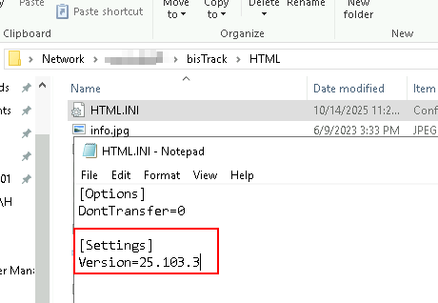
Tips & Tricks
Page Layout
Familiarize yourself with a front-end framework such as Bootstrap, Tailwind, etc. and include your preference in AI prompts
Stuck with a layout issue or error? Ask AI (seriously)
CSS Override: Nuke a component's formatting to start fresh:
BisTrack
Name all dashboard components for easy location
If the Dashboard breaks your JSON into multiple rows, try wrapping with a call to JSON_QUERY()
Add files and script libraries to the HTML folder on your database server and sync to clients by incrementing the version number on HTML.ini (similar to CustomReports.INI) and refreshing client(s)
* HTML.ini functionality for Bistrack Web has been fixed in v 25.2.x
[class*="209386"] {
all: unset;
all: initial;
}
SELECT JSON_QUERY(t1.Top100Sales) AS [Top100Sales]
Notes:
The CSS override provides a way to remove all CSS formatting for a component (the 209386 is a component ID); enter this in the Header section of the Dashboard to effectively wipe out all the CSS that BisTrack typically applies. Very useful for label and data components.
HTML.ini is broken in BT Web, but fixed in 25.2.x.

Slide 17
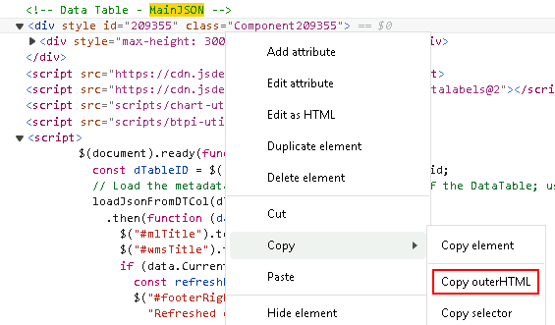
Development & Debug Tips
Develop Locally
Use Inspect/DevTools (F12) to see how the Dashboard HTML renders in BisTrack
Debug using console.log
Duplicate the rendered JSON locally
Find the datatable element containing your JSON and copy the inner/outerHTML
Paste into your local environment and begin coding
I use a lightweight Node.js server that can be started/stopped from within the VS Code terminal (see also python –m http.server <port>)
JavaScript Tips
JavaScript is case-sensitive and 0-indexed
JQuery is a Javascript library to simplify development
Understand blocking execution and synchronous vs asynchronous code
Asynchronous execution can help with responsiveness
Asynchronous code may appear to skip steps or execute out of order when debugging
Notes:
Async is like threading…but different; non-blocking vs. Parallelism
Start pushing AJAX limits and you will eventually run into Cross-Origin Resource Sharing (CORS) restrictions. Hosting a proxy server on a local container can be a nice workaround with the added bonus of being an ETL platform

Slide 18
Creating JSON with SQL
Notes:
Skip through these quickly; intended for reference material post conference

Slide 19

FOR JSON AUTO (Basic)
SQL
Result
SELECT TOP(1) WITH TIES
sr.Name [SalesRep]
, sr.UserID
, sa.DocumentDate
, sa.TotalSales [LastSaleLine]
FROM SalesAnalysis3 sa WITH(NOLOCK)
INNER JOIN SalesRep sr WITH(NOLOCK) ON sr.SalesRepID = sa.SalesRepID
WHERE sr.Deleted = 0
AND sa.TotalSales <> 0
AND sa.DocumentType = 'Invoice'
ORDER BY ROW_NUMBER() OVER(PARTITION BY sa.SalesRepID ORDER BY sa.DocumentDate DESC)
FOR JSON AUTO
[
{
"SalesRep": "Mark Dodson",
"UserID": 35,
"sa": [
{
"DocumentDate": "2025-10-09T00:00:00",
"LastSaleLine": 684.8
}
]
},
{
"SalesRep": "Cody Bartlett",
"UserID": 43,
"sa": [
{
"DocumentDate": "2025-10-09T00:00:00",
"LastSaleLine": 4080
}
]
}
]
Skip...
Notes:
FOR JSON AUTO creates a nested array for the main (not joined) table (sa). When no JOINS are present, this is a simple method to return JSON
212 chars

Slide 20
FOR JSON AUTO, ROOT()
SQL
Result
SELECT TOP(1) WITH TIES
sr.Name [SalesRep]
, sr.UserID
, sa.DocumentDate
, sa.TotalSales [LastSaleLine]
FROM SalesAnalysis3 sa WITH(NOLOCK)
INNER JOIN SalesRep sr WITH(NOLOCK) ON sr.SalesRepID = sa.SalesRepID
WHERE sr.Deleted = 0
AND sa.TotalSales <> 0
AND sa.DocumentType = 'Invoice'
ORDER BY ROW_NUMBER() OVER(PARTITION BY sa.SalesRepID ORDER BY sa.DocumentDate DESC)
FOR JSON AUTO, ROOT('SalesReps')
{
"SalesReps": [
{
"SalesRep": "Mark Dodson",
"UserID": 35,
"sa": [
{
"DocumentDate": "2025-10-09T00:00:00",
"LastSaleLine": 684.8
}
]
},
{
"SalesRep": "Cody Bartlett",
"UserID": 43,
"sa": [
{
"DocumentDate": "2025-10-09T00:00:00",
"LastSaleLine": 4080
}
]
}
]
}
Notes:
Adding ROOT('SalesReps') returns a single SalesReps object; the outer array brackets are removed. See also WITHOUT_ARRAY_WRAPPER
226 chars

Slide 21
FOR JSON PATH (Basic)
SQL
Result
SELECT TOP(1) WITH TIES
sr.Name AS SalesRep
, sr.UserID
, sa.DocumentDate
, sa.TotalSales AS LastSaleLine
FROM SalesAnalysis3 sa WITH(NOLOCK)
INNER JOIN SalesRep sr WITH(NOLOCK) ON sr.SalesRepID = sa.SalesRepID
WHERE sr.Deleted = 0
AND sa.TotalSales <> 0
AND sa.DocumentType = 'Invoice'
ORDER BY ROW_NUMBER() OVER(PARTITION BY sa.SalesRepID ORDER BY sa.DocumentDate DESC)
FOR JSON PATH
[
{
"SalesRep": "Mark Dodson",
"UserID": 35,
"DocumentDate": "2025-10-09T00:00:00",
"LastSaleLine": 684.8
},
{
"SalesRep": "Cody Bartlett",
"UserID": 43,
"DocumentDate": "2025-10-09T00:00:00",
"LastSaleLine": 4080
}
]
Notes:
FOR JSON PATH removes the nested array for a flat structure
194 chars

Slide 22
FOR JSON PATH w/ Dot.Notation Aliases
SQL
Result
SELECT TOP(1) WITH TIES
sr.Name AS [SalesRep.SalesRep]
, sr.UserID AS [SalesRep.UserID]
, sa.DocumentDate AS [Sales.DocumentDate]
, sa.TotalSales AS [Sales.LastSaleLine]
FROM SalesAnalysis3 sa WITH(NOLOCK)
INNER JOIN SalesRep sr WITH(NOLOCK) ON sr.SalesRepID = sa.SalesRepID
WHERE sr.Deleted = 0
AND sa.TotalSales <> 0
AND sa.DocumentType = 'Invoice'
ORDER BY ROW_NUMBER() OVER(PARTITION BY sa.SalesRepID ORDER BY sa.DocumentDate DESC)
FOR JSON PATH
[
{
"SalesRep": {
"SalesRep": "Mark Dodson",
"UserID": 35
},
"Sales": {
"DocumentDate": "2025-10-09T00:00:00",
"LastSaleLine": 684.8
}
},
{
"SalesRep": {
"SalesRep": "Cody Bartlett",
"UserID": 43
},
"Sales": {
"DocumentDate": "2025-10-09T00:00:00",
"LastSaleLine": 4080
}
}
]
Notes:
Use aliases with FOR JSON PATH and dot notation to create nested objects (SalesRep and Sales). This provides precise control over the output.
240 chars

Slide 23
FOR JSON PATH w/ Subqueries
SQL
Result
SELECT TOP(1) WITH TIES
(SELECT
sr.Name AS SalesRep
, sr.UserID
FROM SalesRep sr WITH(NOLOCK)
WHERE sr.SalesRepID = sa.SalesRepID
FOR JSON PATH) AS SalesRepInfo
, sa.DocumentDate
, sa.TotalSales AS LastSaleLine
FROM SalesAnalysis3 sa WITH(NOLOCK)
INNER JOIN SalesRep sr WITH(NOLOCK) ON sr.SalesRepID = sa.SalesRepID
WHERE sr.Deleted = 0
AND sa.TotalSales <> 0
AND sa.DocumentType = 'Invoice'
ORDER BY ROW_NUMBER() OVER(PARTITION BY sa.SalesRepID ORDER BY sa.DocumentDate DESC)
FOR JSON PATH
[
{
"SalesRepInfo": [
{
"SalesRep": "Mark Dodson",
"UserID": 35
}
],
"DocumentDate": "2025-10-09T00:00:00",
"LastSaleLine": 684.8
},
{
"SalesRepInfo": [
{
"SalesRep": "Cody Bartlett",
"UserID": 43
}
],
"DocumentDate": "2025-10-09T00:00:00",
"LastSaleLine": 4080
}
]
Notes:
Using a subquery with FOR JSON PATH to create a nested property (SalesRepInfo)
232 chars

Slide 24
Advanced: JSON Object w/ Multiple Properties
SQL
Result
SELECT J1.salesData
FROM (
SELECT -- Without FOR JSON PATH, this would return two JSON cols
JSON_QUERY(MD.MetaDataJSON) AS [MetaData]
, JSON_QUERY(SI.SalesJSON) AS [SalesInfo]
FROM
( -- Metadata subquery in one column
SELECT
1 AS [UserID]
, GETDATE() AS [CurDateTime]
FOR JSON PATH
) AS MD(MetaDataJSON) CROSS JOIN
( -- Sales info subquery in another column
SELECT TOP(1) WITH TIES
sr.Name AS [SalesRep]
, sr.UserID AS [SalesUserID]
, sa.DocumentDate AS [DocumentDate]
, sa.TotalSales AS [LastSaleLine]
FROM SalesAnalysis3 sa WITH(NOLOCK)
INNER JOIN SalesRep sr WITH(NOLOCK) ON sr.SalesRepID = sa.SalesRepID
WHERE sr.Deleted = 0
AND sa.TotalSales <> 0
AND sa.DocumentType = 'Invoice'
ORDER BY ROW_NUMBER() OVER(PARTITION BY sa.SalesRepID ORDER BY sa.DocumentDate DESC)
FOR JSON PATH
) AS SI(SalesJSON)
FOR JSON PATH, WITHOUT_ARRAY_WRAPPER
) AS J1(salesData)
{
"MetaData": [
{
"UserID": 1,
"CurDateTime": "2025-10-13T15:01:28.903"
}
],
"SalesInfo": [
{
"SalesRep": "Mark Dodson",
"SalesUserID": 35,
"DocumentDate": "2025-10-10T00:00:00",
"LastSaleLine": 3200
},
{
"SalesRep": "Cody Bartlett",
"SalesUserID": 43,
"DocumentDate": "2025-10-10T00:00:00",
"LastSaleLine": 864.96
}
]
}
Notes:
Multiple disparate queries can be joined into a single JSON object using a CROSS JOIN (comma join). This can be useful when writing dashboards to combine data for multiple charts into a single JSON object.

Slide 25
Advanced: Values as Keys
SQL
Result
-- Build the JSON value as a string using a CTE and FOR JSON PATH
; WITH myCTE AS (
SELECT -- Use SalesRep as key with a subquery and FOR JSON PATH as the value
CONCAT('{', '"', p.SalesRep, '"', ':', (
SELECT p.SalesRepID, p.SalesUserID, p.DocumentDate, p.LastSaleLine
FROM SalesRep sr WHERE sr.SalesRepID = p.SalesRepID
FOR JSON PATH), '}') AS JSONResult
FROM (
SELECT TOP(1) WITH TIES
sr.SalesRepID
, sr.Name AS [SalesRep]
, sr.UserID AS [SalesUserID]
, sa.DocumentDate AS [DocumentDate]
, sa.TotalSales AS [LastSaleLine]
FROM SalesAnalysis3 sa WITH(NOLOCK)
INNER JOIN SalesRep sr WITH(NOLOCK) ON sr.SalesRepID = sa.SalesRepID
WHERE sr.Deleted = 0
AND sa.TotalSales <> 0
AND sa.DocumentType = 'Invoice'
ORDER BY ROW_NUMBER() OVER(PARTITION BY sa.SalesRepID ORDER BY sa.DocumentDate DESC)
) p
) -- Aggregate the rows into a single JSON object using a comma separator
SELECT FORMATMESSAGE('[%s]', STRING_AGG(JSONResult,',')) [FinalJSON]
FROM myCTE
[
{
"Mark Dodson": [
{
"SalesRepID": 18,
"SalesUserID": 35,
"DocumentDate": "2025-10-10T00:00:00",
"LastSaleLine": 3200
}
]
},
{
"Cody Bartlett": [
{
"SalesRepID": 27,
"SalesUserID": 43,
"DocumentDate": "2025-10-10T00:00:00",
"LastSaleLine": 864.96
}
]
}
]
Notes:
This example uses the value of the sales rep name field as the key; useful when building dropdown lists or similar UI elements that pull up information based on the selected value. An example might be a query that returns data for multiple branches; the object’s key (shown to the user) could be the branch name. With this data structure, selecting data for a different branch would not require iteration over all objects until a match was found; the branch name would be the key. Consider wrapping result in JSON_QUERY()
223 characters

Slide 26
Advanced: JSON Array
SQL
Result
SELECT JSON_QUERY(CONCAT(
'[',
STRING_AGG(
CONCAT(
'[',
'"', [SalesRep], '",',
[SalesUserID], ',',
'"', CONVERT(VARCHAR(10), [DocumentDate], 101), '",',
[LastSaleLine],
']'
),
','
),
']')
) AS JSONArray
FROM (
SELECT TOP (1) WITH TIES
sr.Name AS [SalesRep],
sr.UserID AS [SalesUserID],
sa.DocumentDate AS [DocumentDate],
sa.TotalSales AS [LastSaleLine]
FROM SalesAnalysis3 sa WITH(NOLOCK)
INNER JOIN SalesRep sr WITH(NOLOCK) ON sr.SalesRepID = sa.SalesRepID
WHERE sr.Deleted = 0
AND sa.TotalSales <> 0
AND sa.DocumentType = 'Invoice'
AND sa.SalesRepID IN (27, 18)
ORDER BY ROW_NUMBER() OVER(PARTITION BY sa.SalesRepID ORDER BY sa.DocumentDate DESC)
) AS salesInfo;
[
[
"Mark Dodson",
35,
"11/05/2025",
5370.4
],
[
"Cody Bartlett",
43,
"11/05/2025",
344.96
]
]
See:
https://datatables.net/manual/data/#Arrays
Notes:
This example returns a simple JSON array that is perfect for matching with datatables (datatables.net)
The original SQL example using TOP(1) WITH TIES is perhaps overly complicated to highlight this concept, but the premise is to use CONCAT and STRING_AGG in much the same way as the "Values as Keys" slide

Slide 27
Consuming JSON with SQL

Slide 28
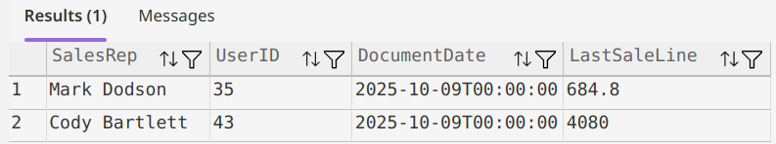
Example 1: Read the ROOT() Example
JSON
SQL
{
"SalesReps": [
{
"SalesRep": "Mark Dodson",
"UserID": 35,
"sa": [
{
"DocumentDate": "2025-10-09T00:00:00",
"LastSaleLine": 684.8
}
]
},
{
"SalesRep": "Cody Bartlett",
"UserID": 43,
"sa": [
{
"DocumentDate": "2025-10-09T00:00:00",
"LastSaleLine": 4080
}
]
}
]
}
SELECT
JSON_VALUE(sr.value, '$.SalesRep') AS SalesRep,
JSON_VALUE(sr.value, '$.UserID') AS UserID,
JSON_VALUE(sa.value, '$.DocumentDate') AS DocumentDate,
JSON_VALUE(sa.value, '$.LastSaleLine') AS LastSaleLine
FROM OPENJSON(@json, '$.SalesReps') AS sr
CROSS APPLY OPENJSON(sr.value, '$.sa') AS sa;
OR
SELECT
sr.SalesRep
, sr.UserID
, sa.DocumentDate
, sa.LastSaleLine
FROM OPENJSON(@json, '$.SalesReps') WITH (SalesRep NVARCHAR(100) '$.SalesRep', UserID INT '$.UserID', sa NVARCHAR(MAX) '$.sa' AS JSON) AS sr
CROSS APPLY OPENJSON(sr.sa) WITH (DocumentDate DATETIME '$.DocumentDate', LastSaleLine DECIMAL(10, 2) '$.LastSaleLine') AS sa;
Notes:
For all following examples, it is assumed that the reader assigns the JSON on the left to a NVARCHAR(MAX) variable named @json
This reads the JSON created in the FOR JSON AUTO, ROOT() slide using two methods; JSON_VALUE and a WITH clause (similar to EXEC sproc WITH RESULT SETS)

Slide 29
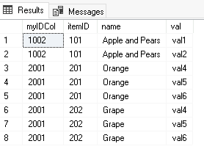
Example 2: Array of Objects with Sub Arrays
JSON
SQL
[
{
"id": 1002,
"myarray": [
"val1",
"val2"
],
"items": [
{
"item_id": 101,
"name": "Apple and Pears"
}
]
},
{
"id": 2001,
"myarray": [
"val4",
"val5",
"val6"
],
"items": [
{
"item_id": 201,
"name": "Orange"
},
{
"item_id": 202,
"name": "Grape"
}
]
}
]
DECLARE @json NVARCHAR(MAX) = ‘...’
-- Use OPENJSON and OUTER APPLY to traverse object
SELECT
root_js.myIDCol
, item.itemID
, item.name
, myval.val
FROM OPENJSON(@json) WITH (myIDCol INT '$.id', items NVARCHAR(MAX) '$.items' AS JSON, myarray NVARCHAR(MAX) '$.myarray' AS JSON) AS root_js
OUTER APPLY OPENJSON(root_js.items) WITH(itemID INT '$.item_id', [name] VARCHAR(20) '$.name') AS item
OUTER APPLY OPENJSON(root_js.myarray) WITH(val VARCHAR(10) '$') AS myVal
Notes:
The example JSON is an array of objects with each object containing an array of unnamed values and an array of objects.
Note, assign the actual JSON value to the @json variable before running.
Define the root path. Note the values that contain arrays (myarray and items) are defined as NVARCHAR(MAX) with the "AS JSON" qualifier.
This qualifer creates a JSON fragment that can be applied (OUTER APPLY here) to tease out the values into a full rowset

Slide 30
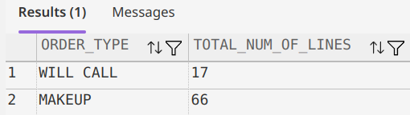
Example 3: WMS Pulse Query – Full Recordset
JSON
SQL: Break into columns/data fragments
{
"columns": [
{
"name": "ORDER_TYPE",
"type": "String",
"value": ""
},
{
"name": "TOTAL_NUM_OF_LINES",
"type": "Decimal",
"value": ""
}
],
"data": [
[
{
"name": "ORDER_TYPE",
"type": "Varchar2",
"value": "WILL CALL"
},
{
"name": "TOTAL_NUM_OF_LINES",
"type": "Decimal",
"value": "17"
}
],
[
{
"name": "ORDER_TYPE",
"type": "Varchar2",
"value": "MAKEUP"
},
{
"name": "TOTAL_NUM_OF_LINES",
"type": "Decimal",
"value": "66"
}
]
],
"error": "Bob’'s your uncle"
}
DECLARE @json NVARCHAR(MAX) = ‘...’
SELECT
/* Return columns and data array as a JSON fragment */
JSON_QUERY(@json, '$.columns') AS Cols
, JSON_QUERY(@json, '$.data') AS Data
/* JSON_VALUE returns a scalar value */
, JSON_VALUE(@json, '$.error') AS Errmsg
SQL: Read the data fragment
SELECT
j.ORDER_TYPE,
j.TOTAL_NUM_OF_LINES
FROM OPENJSON(@json, '$.data')
WITH (
ORDER_TYPE NVARCHAR(50) '$[0].value',
TOTAL_NUM_OF_LINES DECIMAL '$[1].value'
) AS j;
Notes:
Pulse queries are returned with a columns array, a data array, and an error message (datatable.net datatable objects have a similar config).
The top example breaks down column/data JSON into the chief components to be dealt with separately as needed.
The second example parses the Data col
Notice the use of JSON_QUERY (extracts JSON fragment) and JSON_VALUE (extracts scalar data)
The second example assumes the fragment was assigned to the @json variable. It works directly with the “data” object using a WITH clause
Define the root path. Note the values that contain arrays (myarray and items) are defined as NVARCHAR(MAX) with the "AS JSON" qualifier.
This qualifer creates a JSON fragment that can be applied (OUTER APPLY here) to tease out the values into a full rowset

Slide 31
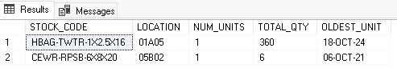
Example 4: WMS Pulse Query – Data Recordset
JSON
SQL
[
[
{
"name": "STOCK_CODE",
"type": "Varchar2",
"value": "HBAG-TWTR-1X2.5X16"
},
{
"name": "LOCATION",
"type": "Varchar2",
"value": "01A05"
},
{
"name": "NUM_UNITS",
"type": "Decimal",
"value": "1"
},
{
"name": "TOTAL_QTY",
"type": "Decimal",
"value": "360"
},
{
"name": "OLDEST_UNIT",
"type": "Date",
"value": "18-OCT-24"
}
],
[
{
"name": "STOCK_CODE",
"type": "Varchar2",
"value": "CEWR-RPSB-6X8X20"
},
{
"name": "LOCATION",
"type": "Varchar2",
"value": "05B02"
},
{
"name": "NUM_UNITS",
"type": "Decimal",
"value": "1"
},
{
"name": "TOTAL_QTY",
"type": "Decimal",
"value": "6"
},
{
"name": "OLDEST_UNIT",
"type": "Date",
"value": "06-OCT-21"
}
]
]
DECLARE @json NVARCHAR(MAX) = ‘...’
SELECT
JSON_VALUE(value, '$[0].value') AS [STOCK_CODE]
, JSON_VALUE(value, '$[1].value') AS [LOCATION]
, JSON_VALUE(value, '$[2].value') AS [NUM_UNITS]
, JSON_VALUE(value, '$[3].value') AS [TOTAL_QTY]
, JSON_VALUE(value, '$[4].value') AS [OLDEST_UNIT]
FROM OPENJSON(@json) AS root_js
OR
SELECT
j.STOCK_CODE
, j.LOCATION
, j.NUM_UNITS
, j.TOTAL_QTY
, j.OLDEST_UNIT
FROM OPENJSON(@json)
WITH (STOCK_CODE NVARCHAR(100) '$[0].value', LOCATION NVARCHAR(50) '$[1].value'
, NUM_UNITS DECIMAL(18,2) '$[2].value', TOTAL_QTY DECIMAL(18,2) '$[3].value'
, OLDEST_UNIT DATE '$[4].value') AS j
Notes:
Changing $[0].value to $[0].type in the above SQL would return ‘Varchar2’ for the STOCK_CODE column

Slide 32
New with MS SQL Server 2025
Native JSON datatype (instead of NVARCHAR(MAX))
JSON indexing
Updates to JSON Path Expressions (incl. Array wildcards and WITH ARRAY WRAPPER)

Slide 33
Dynamic Dashboard Drilldowns

Slide 34
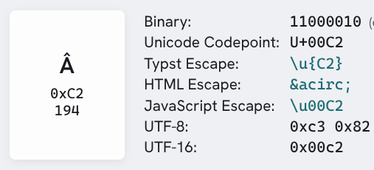
Dynamic Dashboard Drilldowns
Dynamic Dashboard Drilldowns are special links in the format:
dislinkDrillDown<ComponentID>Â&nbsp;%drilldownID1%=<DrillDownID1Value>Â&nbsp;
Where <ComponentID> is the dashboard component ID and,
Â = ASCII 194
Example:
DashboardComponent.DashboardComponentID = 209359
%drilldownID1% = 100
%drilldownID2% = 200
%drilldowncaption% = ‘Thanks for Clicking’
<a href="dislinkDrillDown209359Â&nbsp;%drilldownID1%=100Â&nbsp;%drilldownID2%=200Â&nbsp;%drilldowncaption%='Thanks for clicking!'Â&nbsp;”>
Notes:
Drilldowns are a useful part of the BisTrack BI environment and can be used with dynamic dashboards as well.
The "circumflex" letter Â is used with &nbsp; as a delimiter for link components; Â = %C3%82 when URLENCODED

Slide 35
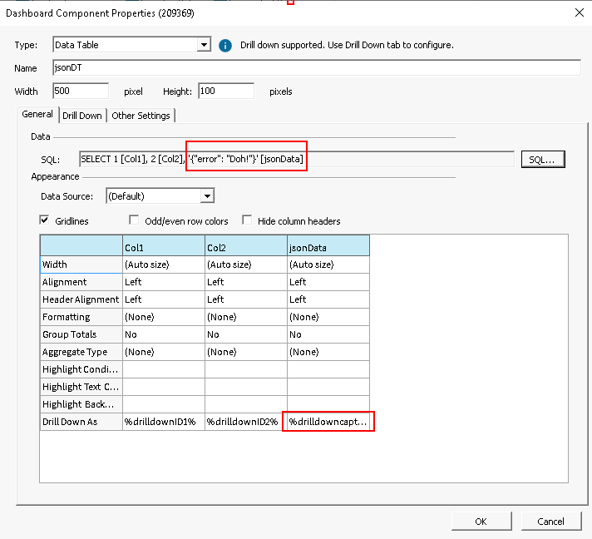
Dynamic Dashboard Drilldowns (Cont.)
Visible Datatables that return JSON don't (currently) work with drilldowns as the JSON value is not wrapped in apostrophes or URL encoded
For JSON data to be passed and used in a drilldown link:
JSON must be passed as a caption/string (not ID)
All strings must be wrapped with apostrophes ‘’ (🪳)
JSON must be URLEncoded
URLEncoded JSON must fit (browser-specific) URL size limits
Decoded by the recipient
Passing JSON in a Drilldown Example:
%drilldowncaption%='%7B%22error%22%3A%20%22Doh%22%7D'Â&nbsp; = ‘{"error": "Doh"}’
Notes:
Datatables are typically hidden anyway
No native URLEncode function in SQL Server
All text values must be wrapped with an (additional) apostrophe; feature? Bug?

Slide 36
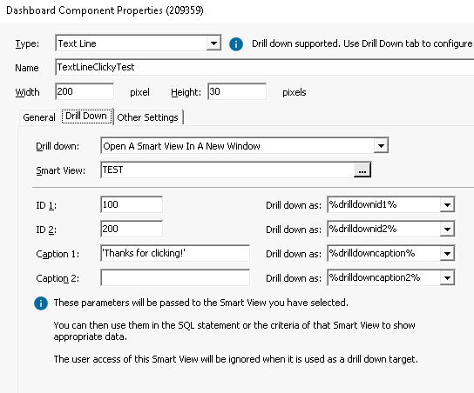
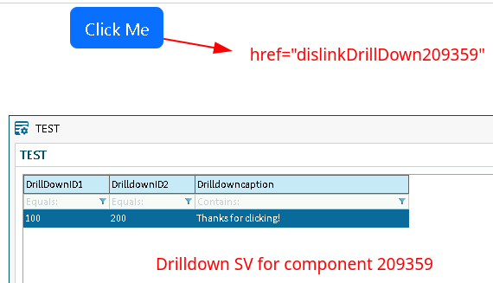
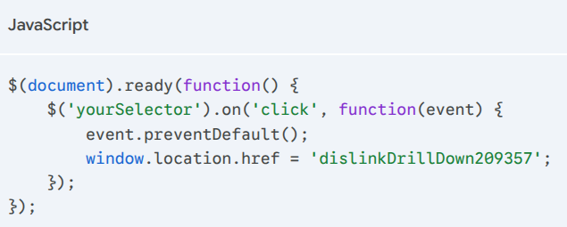
Dynamic Dashboard Drilldowns (Cont.)
Extending Drilldowns:
Each drilldown link that you wish to include as a drilldown option (such as a Crystal Report or SV) must point to an existing component on the dashboard
Add a Data Table or Text Line component with a Drilldown
Hide in Other Settings
Using the component ID, create a link using the dislinkDrillDown format. Leave param values (ID 1, ID 2, etc.) empty if you wish to send values via a link
Link to BisTrack content using any combination of HTML and JavaScript
Notes:
The DataTable component allows for more hardcoded values and is essentially freeform; whereas TextLine components are more limited
Import and Inspect the Drilldowns dashboard (.xml) for examples
If parameters are hardcoded for a component (e.g., the image shown in this slide), those values will override any custom links. When left empty, the links can supply the values.
When you aren't creating your own links as shown in these slides, the DataTable component is more customizable for drilldowns. However, when using links, it doesn't matter.
In the screenshot, a hidden Text Line component links to the "TEST" SmartView. A blue "Click Me" button is rendered in the dashboard with a link as specified in red. When clicked, the TEST SmartView is opened and the hardcoded values passed. Note that only the component is needed to pass the static values; can be overridden with a customized link
Create hidden components for all drilldown targets; reports, smartviews, dashboards, etc..
Can be a tedious process
Link could be to a specific component with hardcoded values or parameterized in a link and sent with the Â&npsp; URL method. E.g., <a href="dislinkDrillDown209357Â&nbsp;%drilldownID1%=2005Â&nbsp;%drilldownID2%=147Â&nbsp;%drilldowncaption%='Thanks for clicking!'Â&nbsp;”>
For table data use tr/td onclick=”dislinkDrillDown209359” to make a row or cell clickable
Single apostrophes that encapsulate text can be URL encoded with %27 to avoid HTML link issues.

Slide 37
SVG Dashboards
Repo: SVG Dashboards Examples 1, 2, 3

Slide 38
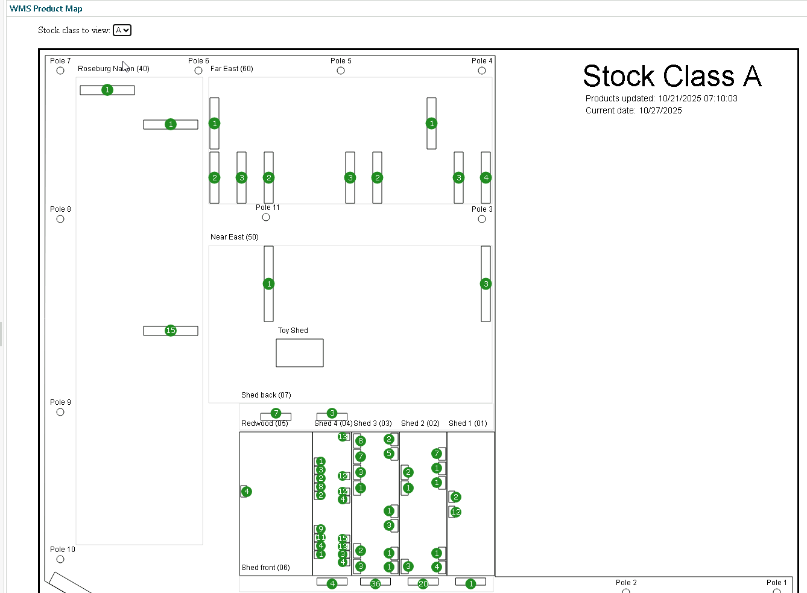
Scalable Vector Graphics (SVG) Dashboards
Resolution independent
Smaller file sizes; fast loading
SVG elements may be manipulated using CSS and JavaScript
Tooltips
Hover options
Gradients
Patterns
Show/Hide/Animations
Export to PNG

Slide 39
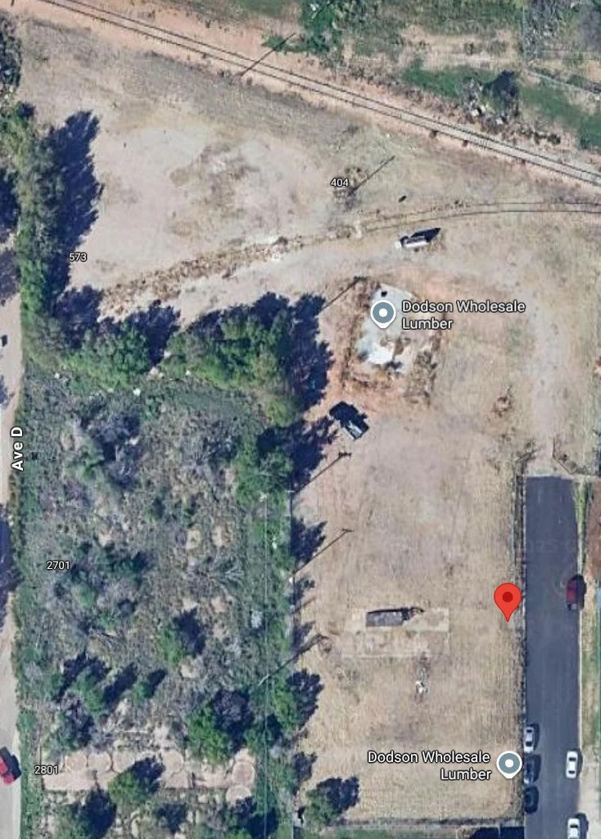
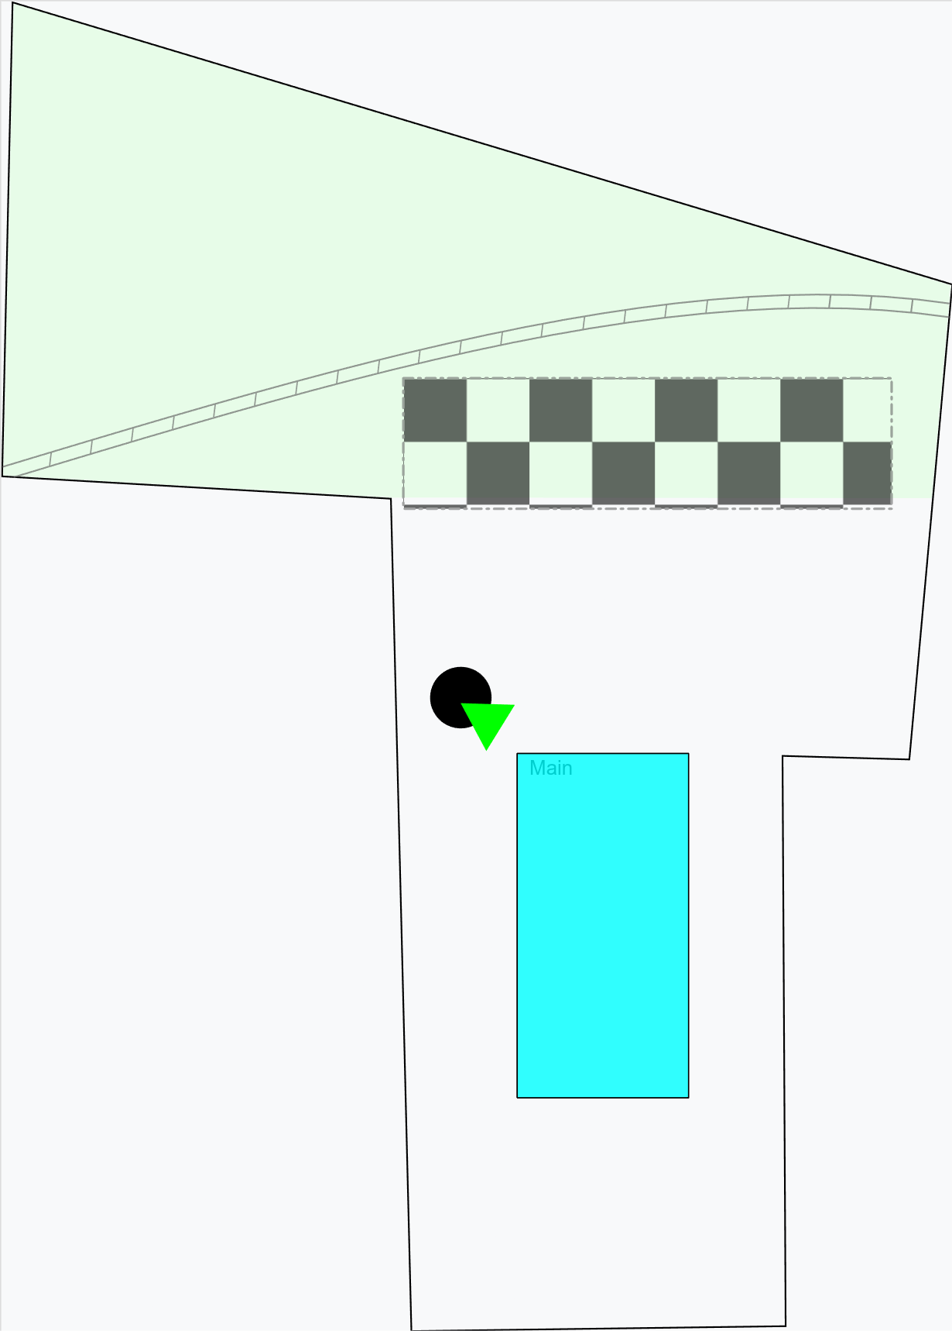
My SVG Creation Process
Download or log in to the vector illustrator program of your choice (e.g., Adobe Illustrator, Canva, etc.). I’m using Inkscape (FOSS)
My examples recreate our new reload facility with a Google Maps screenshot as the basis
I imported the Google Maps bitmap and set transparency low for an “onion-skin” base layer
Using a new layer, I traced the outline using shapes, Bezier curves, lines, etc.
Optional: Convert each shape to a path object (Path/Object to Path)
Remove the base layer when finished. For embedded SVG, I found that having only one layer made the file easier to read. YMMV.
Naming each object (Object/Object Properties/ID → Set) also helped when manipulating the SVG elements inside an HTML
Save as "Plain" SVG
Notes:
All shapes can be converted to paths; it’s a universal shape definition. Use this method if you need a simple way to define SVG shapes (e.g., developing a database solution).
Most SVG programs have a native SVG format that expands the SVG standard; avoid using this when exporting for web use (thus, “Plain” SVG)
A few free SVG sites for logos and shields:
https://worldvectorlogo.com/
https://simpleicons.org/
https://shields.io/

Slide 40
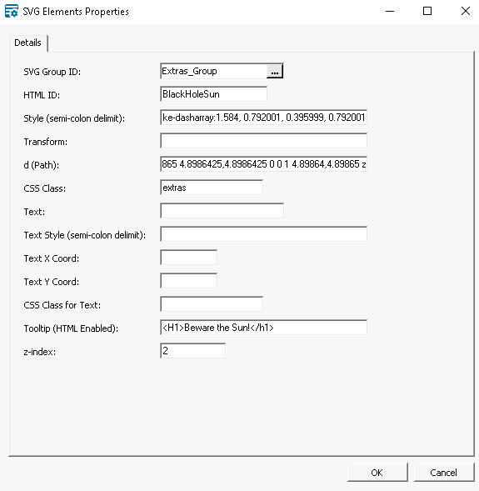
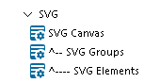
Loading SVG in HTML
Determine how to load the SVG:
Store path definitions in a Smart Object and load using JSON (Example 1)
Load the .svg file using AJAX/Fetch (Example 2)
Load the .svg file using an OBJECT element (Example 3)
All allow for interactivity and styling
SVG Element
HTML svg, g elements
Javascript svg.setAttribute("viewBox", canvas.ViewBox);
Groups (G Element) consist of one or more elements that can be manipulated together
Z-index: No z-index concept. The first item drawn is the base, subsequent items draw over the top
Notes:
Three examples of SVG loading and manipulation can be found in the repo
Preference comes down to how you want to enter, edit, and (optionally) version control SVG data; within the Smart Object UI or editing files directly
see also SQL/svg-json.sql
The img element can also be used, but won't be interactive.

Slide 41
Charting

Slide 42
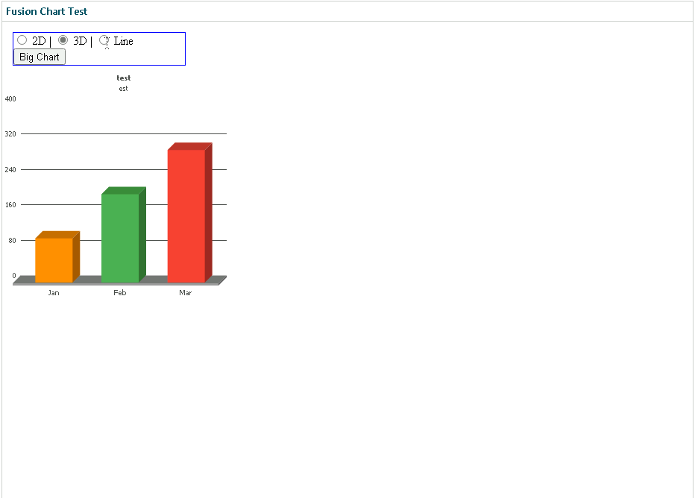
FusionCharts
Updated in 25.1.? to allow JavaScript access to rendered charts
The upcoming 25.2 release will also update FusionCharts to version 4.2.x
The new charts are rendered as SVG
const newChart = new FusionCharts({
type: 'column2d',
renderAt: 'newFC',
width: newWidth,
height: newHeight,
dataFormat: 'json',
dataSource: {
chart: {
caption: 'Orders by Branch',
subCaption: '',
xAxisName: 'Branch',
yAxisName: 'Number of Orders',
theme: 'fusion',
bgColor: 'FFFFFF',
bgAlpha: '100'
},
data: chartData
}
});
newChart.render();

Slide 43
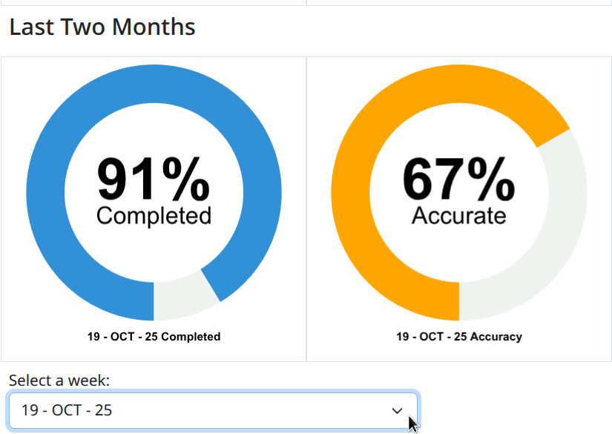
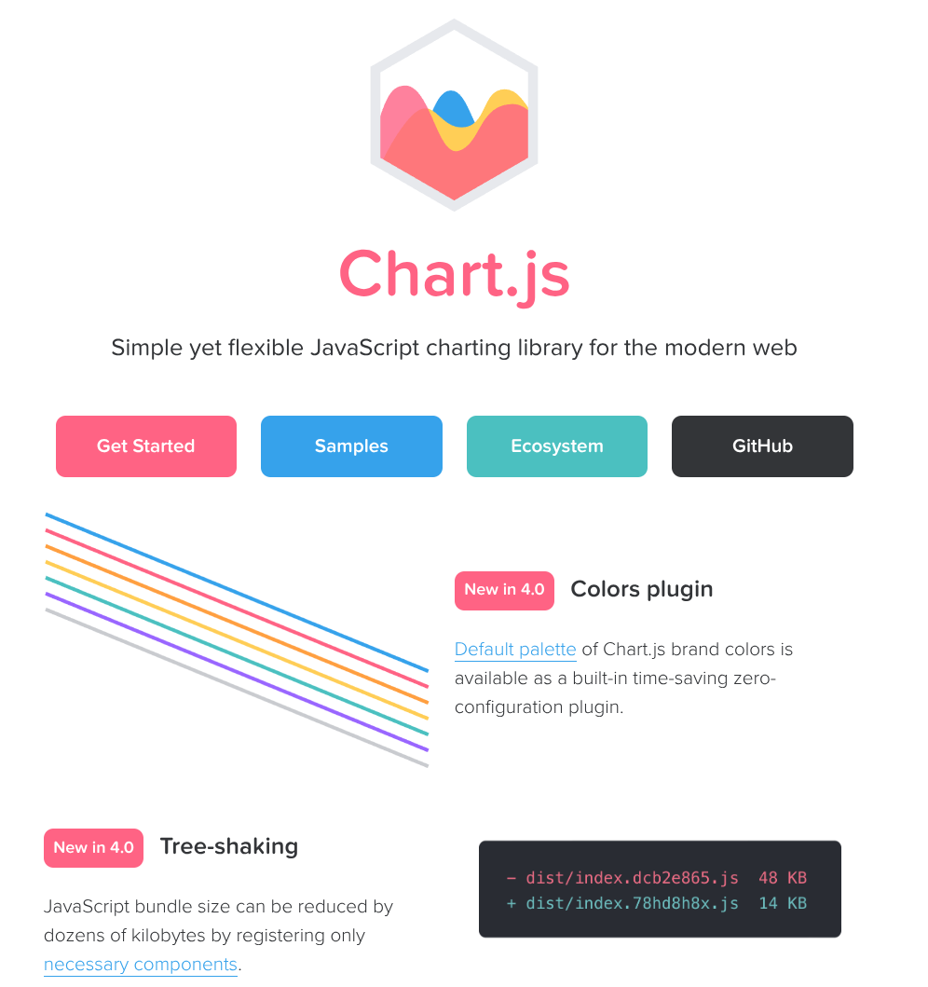
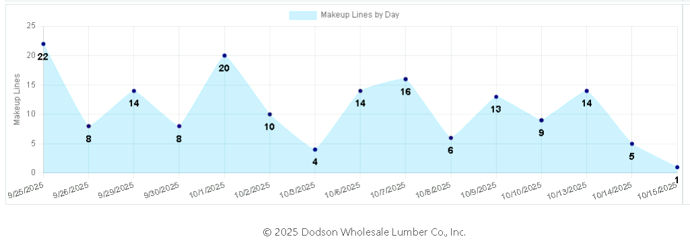
Charts.js Intro
Charts.js is an open-source JavaScript charting library
Relies on HTML5 Canvas (not SVG)
Resolution-dependent bitmap canvas for rendering graphics
Manipulated via JavaScript const ctx = canvas.getContext("2d");
Highly configurable and customizable
FusionCharts alternative
See also Google Charts, D3 (Advanced), et. al.

Slide 44
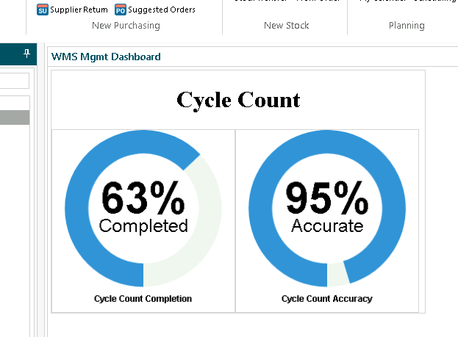
Charts.js: QlikView Gauge
Use Charts.js doughnut chart
Make the cutout large (70% ish)
Utilize the “beforeDatasetsDraw” plugin hook
Draw a white circle in the middle of the donut
Add text on top of the white circle
Render the rest of the donut as usual
Optionally, bind to a form element’s onChange event to update displayed values for the selection
Note: For this widget, each dataset is a part of the whole; for the 95% accuracy calculation in the example, dataset 1 might be 95, and dataset 2 would be 5. E.g., 95/(95+5) = 0.95
Notes:
See chartsjs-example.html in the repo for an example
Each dataset is a slice of the full pizza; Charts.js will add up the size of the full pizza by counting all the slices
The beforeDatasetsDraw plugin hook allows custom drawing operations to occur after the axes have been drawn but before the datasets themselves are rendered.

Slide 45
Microsoft PowerBI
Notes:
Next are some slides on leveraging an external BI tool, Microsoft's PowerBI in this case, for some advanced data review options. We need to note that other BI solutions are available, like Grow, Tableau, and other platforms.

Slide 46
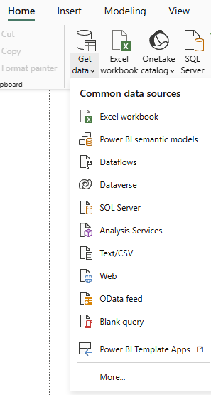
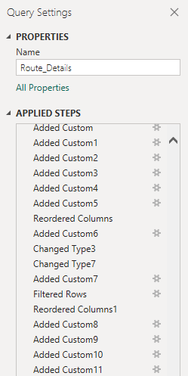
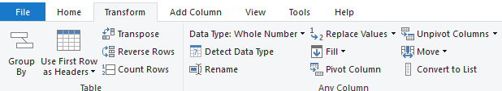
Importing Data into PowerBI
Supported Data Sources:
Excel, CSV, XML, JSON
SQL Server, Oracle, other databases
Online services (Sharepoint, Salesforce, Google Analytics)
APIs and web data
Initiate data import in Power BI Desktop
Home → Get Data
Provide authentication if necessary
Use Power Query Editor to:
Clean/Transform data
Merge Tables
Filter rows and columns
Create calculated columns/measures
Notes:
Import data using database credentials on SQL server data import option: either choose entire tables or write a query
Queries are helpful because your data is filtered prior to the PowerBI import, and you will have less data manipulation to do in the PowerBI software
PowerBI primarily works in M code and DAX
Power Query Editor is no code/low code but does let you manipulate the M code yourself (if you want to)
DAX is primarily used for measures, calculated columns and calculated tables and there are options to create these without coding them yourself
Useful tip: Create a date table to avoid missing dates/inconsistencies in visualizations by date
From some research into DAX: “DAX's Time Intelligence functions only work with continuous range of dates, you won't be able to use them if your table has a missing date, a date table allows you to store complex logics of time travel in just a small table with few hundred/thousand rows”

Slide 47
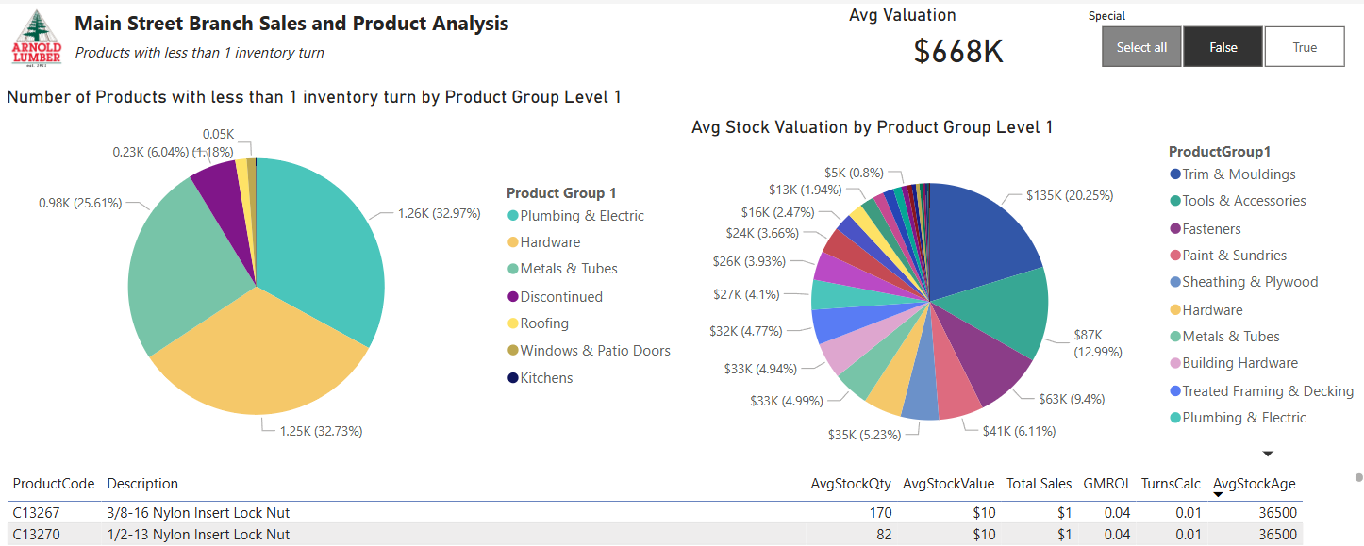
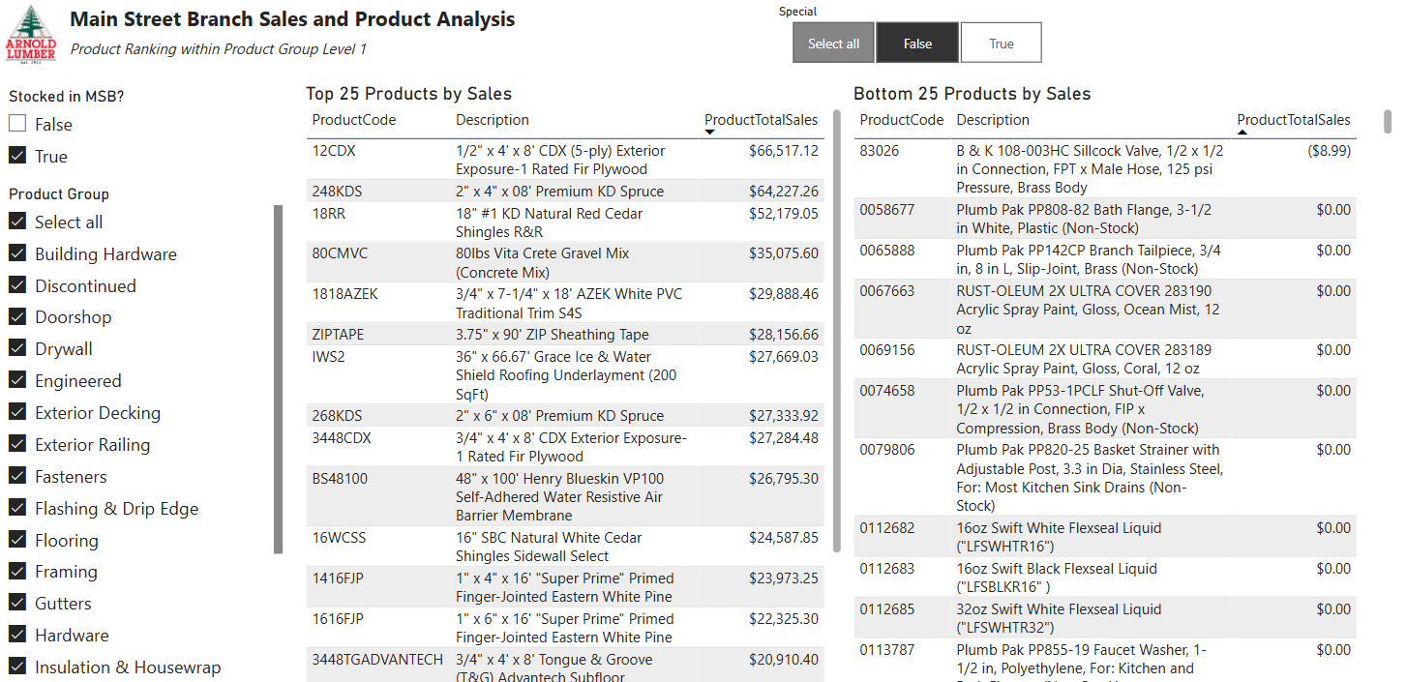
BisTrack data in Power BI
Use SQL stored procedures to stage BisTrack data for your PowerBI report rather than loading entire BisTrack tables
Basic visuals:
Data Table / Matrix
Bar Chart/ Column Chart
Line Chart
Pie Chart / Donut Chart
Use slicers to allow users to dynamically filter data
Notes:
**Sharing reports via the web version of PowerBI does require both users to have PowerBI pro licensing

Slide 48
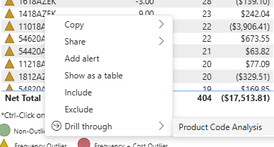
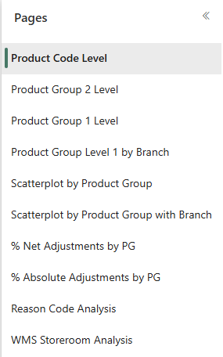
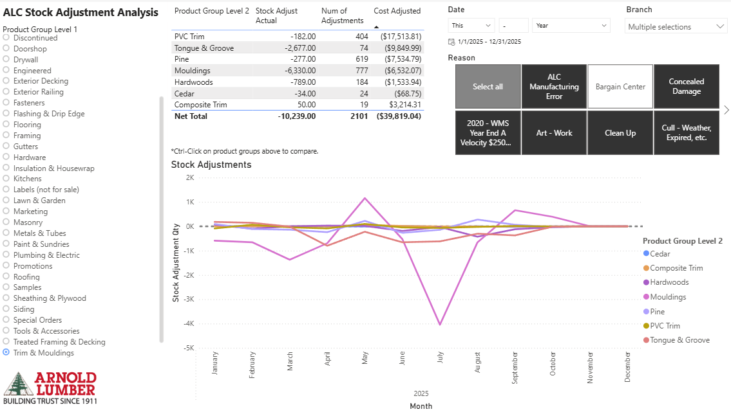
Example: Stock Adjustments in PowerBI
Create different report pages for different analysis types
Filters for date range, branch, product group, and adjustment reason code
Drill throughs to review specific data (e.g., specific product code, specific branch, etc.)
Line chart helps us see patterns in our stock adjustments

Slide 49
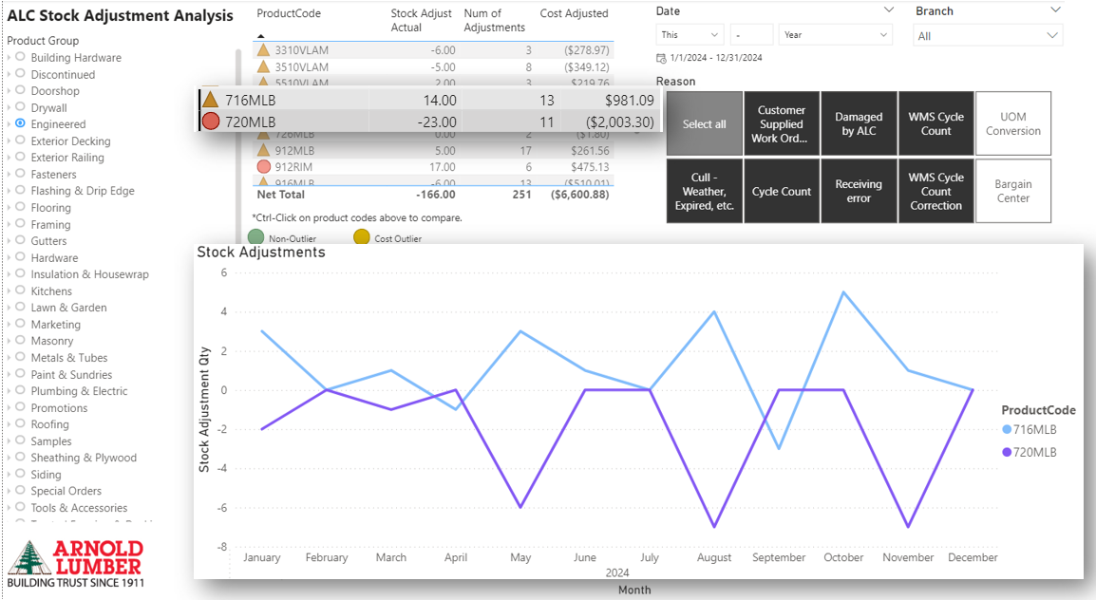
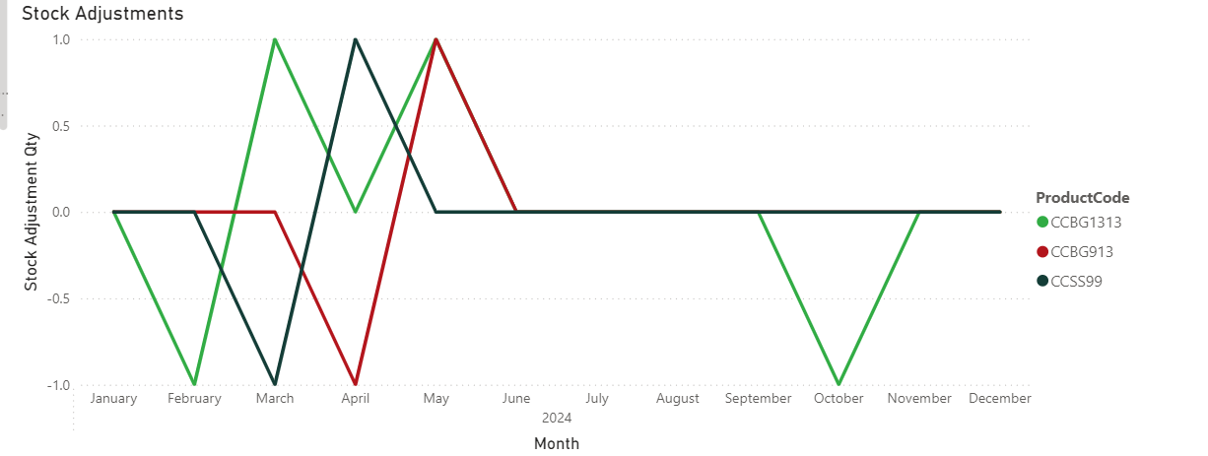
Example: Stock Adjustments in PowerBI
Exploring the data in the PowerBI report led us to notice multiple different patterns
Frequent adjustments that, when mapped together, net 0 qty lost – customer likely received a 20’ product when purchasing a 16’ product
Adjustments over time involving similar-looking or similarly named products – likely misidentification by the person cycle counting
Notes:
First Example: products were physically located very close together, this led us to label the locations better or move one of the products so they aren’t directly next to each other
Second Example: noticing where the skus are, why they are getting mixed up, etc

Slide 50
For the WMS users out there...
Notes:
The next few slides are showing realtime dashboard interaction.

Slide 51
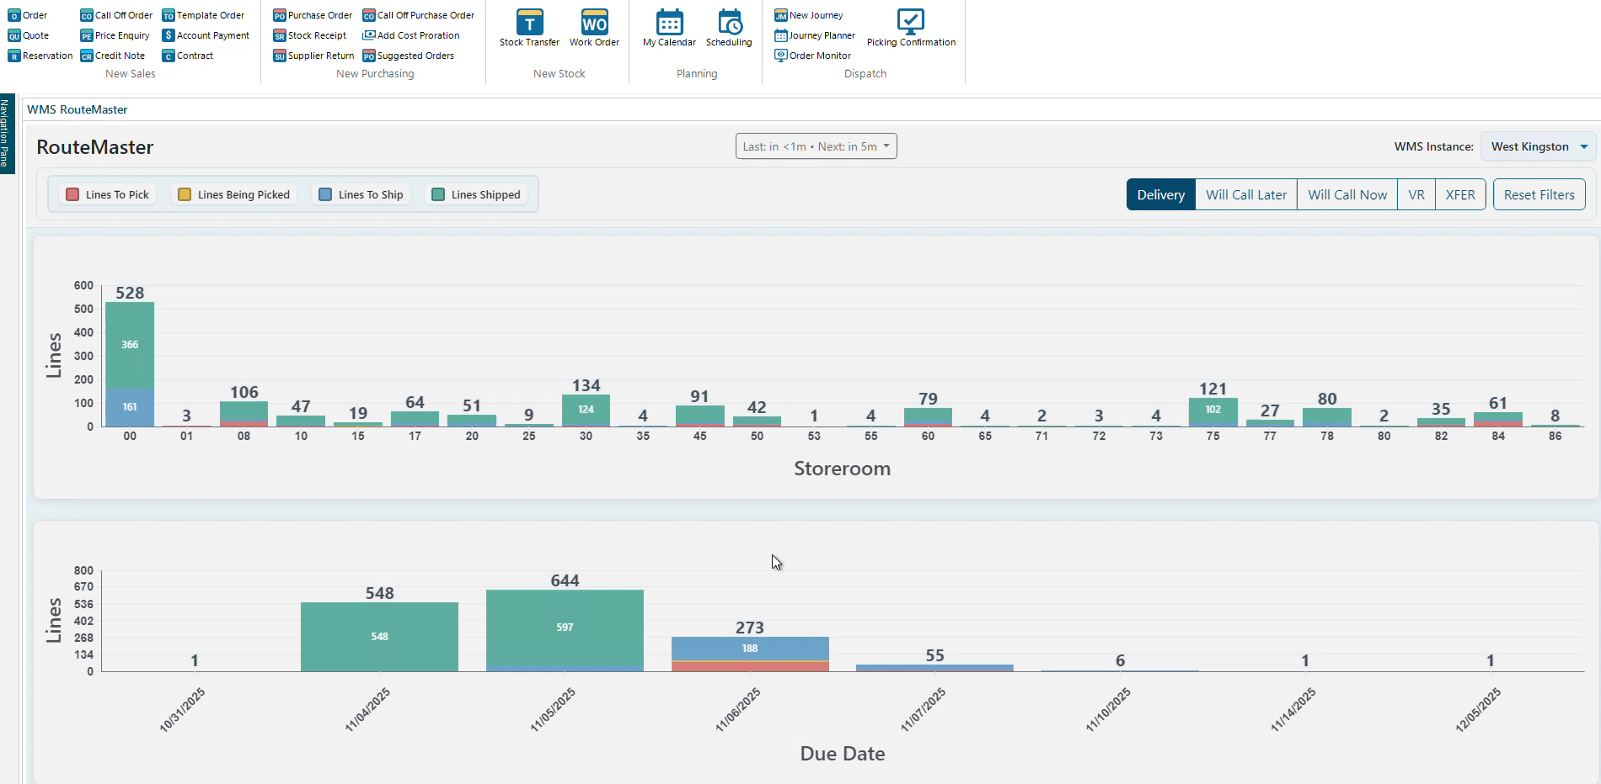
How about WMS RouteMaster Charts in BisTrack?
Notes:
This dashboard is a very complex set of D3 charts, Javascript, and HTML and CSS coding with a Node backend and a MySQL data cache server. There is a dark mode; and it remembers your preferences for line types, order types, and a default branch, and supports automatic refreshing based on metadata fed in by the backend system. The dashboard sleeps when not on an active web browser tab to keep data fetches low, and then knows when it's reactivated and pulls a data refresh automatically and instantly. The top chart is storeroom based, and the bottom is date based. Zooming into either chart also updates the other. Right clicking on a segment launches a table of the line type data for easy copying to review in BisTrack or WMS Web UI.

Slide 52
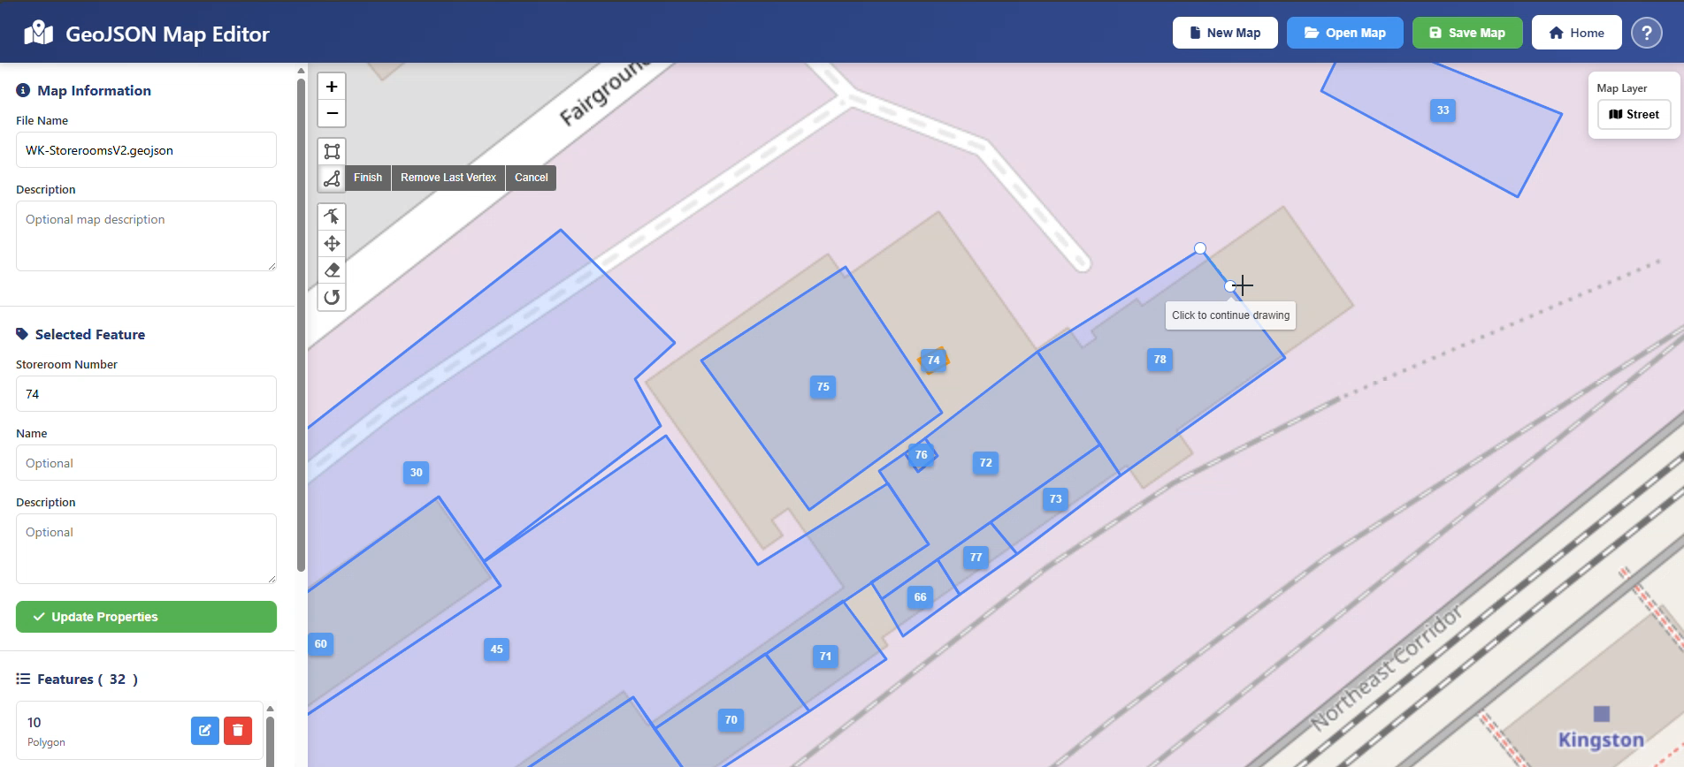
Editing WMS Storerooms directly on a map in a web browser:
Notes:
It can help to visualize your WMS cycle count data using a map with your storerooms displayed as Steve demo'd earlier with the storeroom layout saved in SVG format in a BisTrack Smart Object. This video demonstrates a custom built HTML dashboard using JavaScript, OpenMaps, and Leaflet, to draw and edit WMS storerooms directly on a map without having to go through the process of using 3rd party software and exporting data, and then still needing to convert the map file into an acceptable format to display. We're simply generating and exporting GeoJSON, a known format for creating layers for displaying map data in various BI tools. And then...

Slide 53
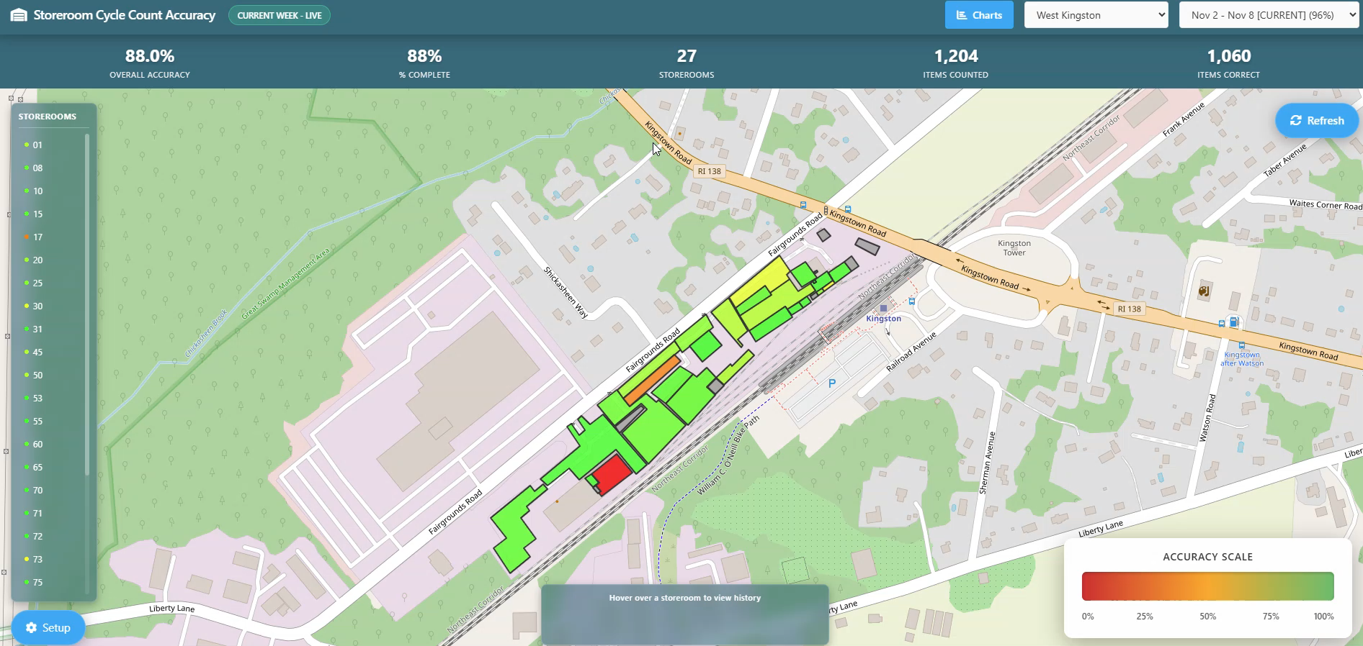
Viewing your WMS Cycle Count history on that same map:
Notes:
We're leveraging more custom dashboarding tools to display that storeroom layout data using bascially the same mapping technology as before. We are throwing the proverbial kitchen sink's worth of BI at it to show WMS Cycle Count history. A core focus on creating these Dashboards was to make them very user friendly on the front end, with a very strong focus on performance. These dashboards are built on Node, Javascript, HTML and CSS, MySQL – with Microsoft SQL as an option for data caching, too, and a heavy dose of AI assistance for the development and refinement process.

Slide 54
Link to GitHub repo:
https://github.com/rhp997/Insights2025BI

